Slide 1
Introduction to Azure Health Bot

Slide 2

Speaker:
Shreyan J D Fernandes
Beta Microsoft Learn Student Ambassador
Worked in a Startup
Hackathon Enthusiast
Open Source Contributor
MTA Certified
Blogger
Areas of Interest:
Artificial Intelligence, Blockchain, DevOps, WebDev, Augmented Reality,
Cloud Computing, IoT & Robotics
LinkedIn: https://www.linkedin.com/in/shreyan-j-d-fernandes-227789147
GitHub: https://github.com/shreyan1999
Dev.to : https://dev.to/shreyan1999

Slide 3

What is Azure Health Bot?
The Azure Health Bot service is a cloud platform that empowers developers in healthcare organizations to build and deploy compliant virtual health assistants and health bots.
The service combines built-in medical intelligence with natural language capabilities and more.
It allows healthcare organizations to give people access to trusted and relevant healthcare services and information.
Notes:
The Azure Health Bot service is a cloud platform that empowers developers in healthcare organizations to build and deploy compliant virtual health assistants and health bots. These tools take advantage of AI and help healthcare organizations to improve processes and reduce costs.
The service combines built-in medical intelligence with natural language capabilities and more.
It allows healthcare organizations to give people access to trusted and relevant healthcare services and information.
Healthcare organizations often have a wide range of users. To meet the diverse expectations of those users, the Health Bot service simplifies the process of creating a health bot. The service also simplifies the integration of the bot with existing systems in the organization that are accessed by patients, nurses, doctors, and other representatives.

Slide 4

Enhancing usability
To enhance the usability of the health bot, organizations can give it a personal touch by:
Introducing custom scenarios into it.
Integrating it with other IT systems and data sources.
Get started with a custom scenario
The Azure Health Bot service supports several built-in scenarios.
For example, the bot can triage a medical condition or find information about a disease.
You can also design custom scenarios in the Health Bot service that fit your organization's needs.
Notes:
To enhance the usability of the health bot, organizations can give it a personal touch by:
Introducing custom scenarios into it.
Integrating it with other IT systems and data sources.
These capabilities give users a customized experience each time they interact with the health bot.

Slide 5
Interrupting & Breaking Scenario

Slide 6
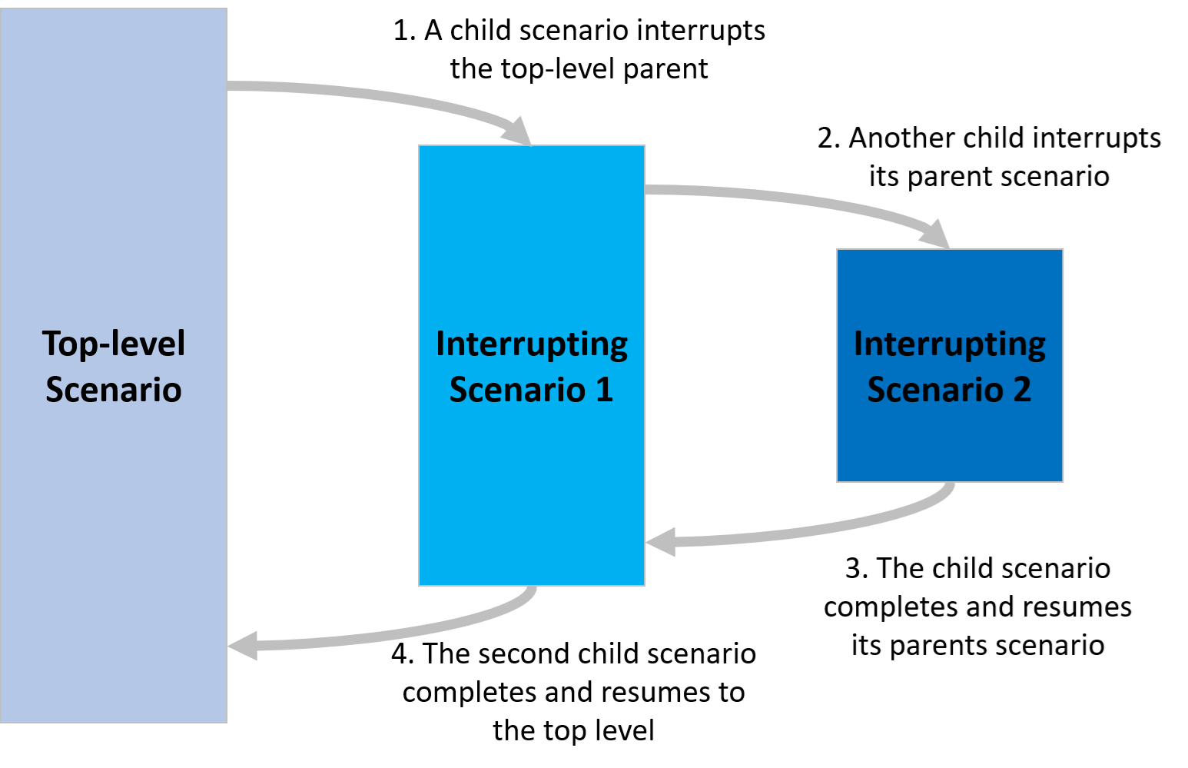
What is an interrupting scenario?
Scenarios defined as interrupting are allowed to interrupt other scenarios.
Notes:
Scenarios defined as interrupting are allowed to interrupt other scenarios. If the active scenario receives an unexpected response that has an interrupting intention, the interruption mechanism is engaged.
The response is unexpected if it doesn't comply with the data type for the current step in the scenario. For example, if a step is expecting a yes/no response and the user enters an unsuitable answer, the bot tries to identify an interrupting intention.
Scenario steps that expect a text response behave differently. They always try to identify an interrupting intention. If the intent score is higher than a 50 percent likelihood, the interrupting scenario is triggered.
System scenarios have modified behavior when they're interrupting. Typically, they're made shorter to minimize the extent of the interruption. For example, the help command doesn't show items that are not interrupting.
The interrupting scenario displays a returning message before resuming the parent. You can configure this message in the Azure portal.

Slide 7
What is a breaking scenario?
In some cases, it doesn't make sense to return to the parent scenario.
For example, if a user wants to delete their data in the middle of a scenario, they can't resume after the deletion.
Some interruptions are able to "break" their parents. If a scenario is configured as breaking, the parent scenario is not resumed after the child scenario has finished.
Notes:
In some cases, it doesn't make sense to return to the parent scenario.
For example, if a user wants to delete their data in the middle of a scenario, they can't resume after the deletion.
Some interruptions are able to "break" their parents. If a scenario is configured as breaking, the parent scenario is not resumed after the child scenario has finished.

Slide 8
Building a Basic Scenario

Slide 9
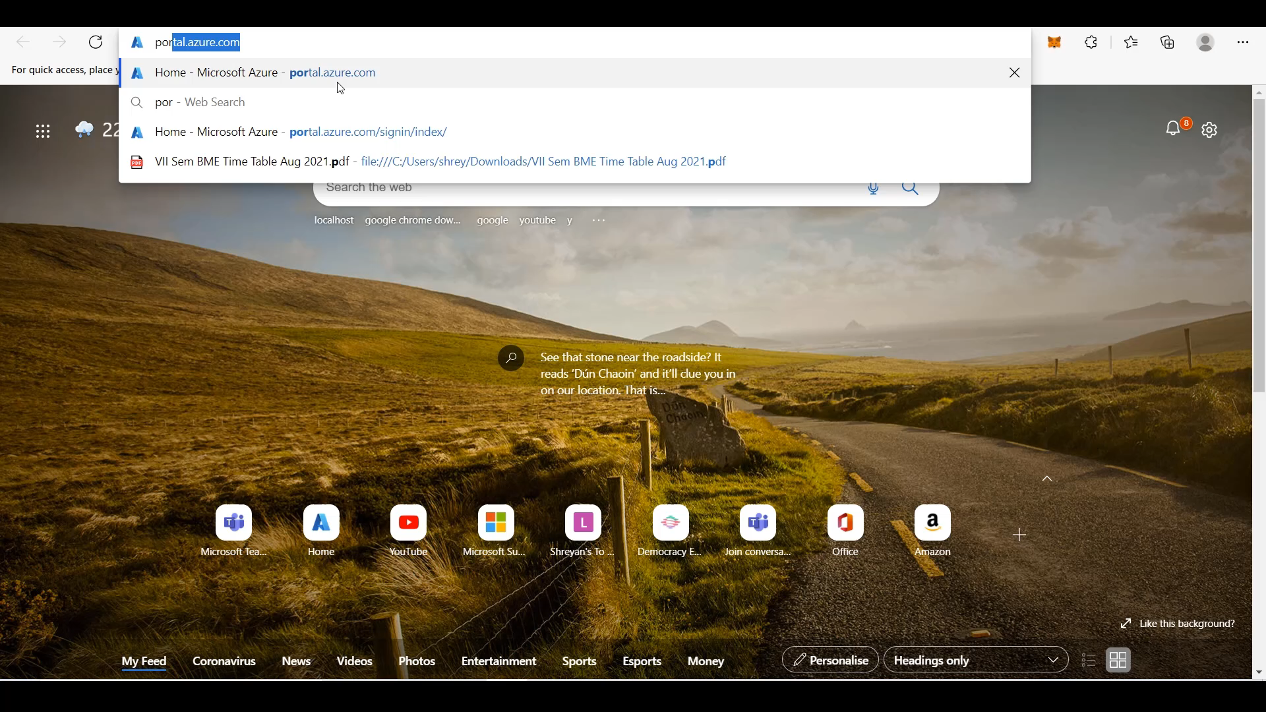

Slide 10

Healthcare organizations around the world are using the Azure Health Bot service to improve patient outcomes and reduce costs.
Microsoft partners have built health bots that help patients check symptoms, find appropriate care, and look up nearby doctors.
The examples in this module should help you understand the impact of the service in healthcare: https://docs.microsoft.com/en-us/learn/modules/health-bot-case-studies/
Customers Stories of organizations using Azure Health Bot are also available in the Azure Health Bot website: https://azure.microsoft.com/services/bot-services/health-bot/#customer-stories
Notes:
Healthcare organizations around the world are using the Azure Health Bot service to improve patient outcomes and reduce costs.
Microsoft partners have built health bots that help patients check symptoms, find appropriate care, and look up nearby doctors.
The examples in this module should help you understand the impact of the service in healthcare.
Customers Stories of organization using Azure Health Bot are also available in the Azure Health Bot website: Azure Health Bot customer stories
"Thanks to everyone for attending today's session and contributing in the chat window with your questions and comments.
Thanks Rodanthi and Gregory for co-hosting with me today!
Join us back here at our next Learn Live session, we look forward to seeing you then!“
Have a great day

Slide 11


